Slide 1
Trees
Presentation for use with the textbook Data Structures and Algorithms in Java, 6th edition, by M. T. Goodrich, R. Tamassia, and M. H. Goldwasser, Wiley, 2014
Mammal
Dog
Pig
Cat

Slide 2
Implementing Trees
8.3

Slide 3
Implementing Trees
We looked at two abstract base classes, AbstractTree and AbstractBinaryTree.
Some useful methods implemented there.
No decision yet about how the tree will be implemented
One natural choice: a linked structure, like linked lists

Slide 4
Linked Structure for Trees
A node is represented by an object storing
Element
Parent node
Sequence of children nodes
Node objects implement the Position ADT
Parent
Children
∅
Element
B

Slide 5
Linked Structure for Trees
Element
Parent node
Sequence of children nodes
∅
B
B
∅
∅
A
D
F
A
D
F
C
E
∅
∅
C
E

Slide 6
Linked Structure for Binary Trees
8.3.1

Slide 7
Linked Structure for Binary Trees
A node is represented by an object storing
Element
Parent node
Left child node
Right child node
Node objects implement the Position ADT
Parent node
Left node
Right node
∅
B
element

Slide 8
Linked Structure for Binary Trees
Element
Parent node
Left child node
Right child node
∅
B
∅
∅
B
A
D
A
D
∅
∅
∅
∅
C
E
C
E

Slide 9
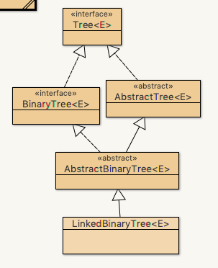
Linked Binary Tree
Open up DSAJ-sourcecode with BlueJ
find package net.datastructures
open
file LinkedBinaryTree.java
Locate methods
getParent()
getLeft()
getRight()

Slide 10
Array-Based Representation of Binary Trees
8.3.2

Slide 11
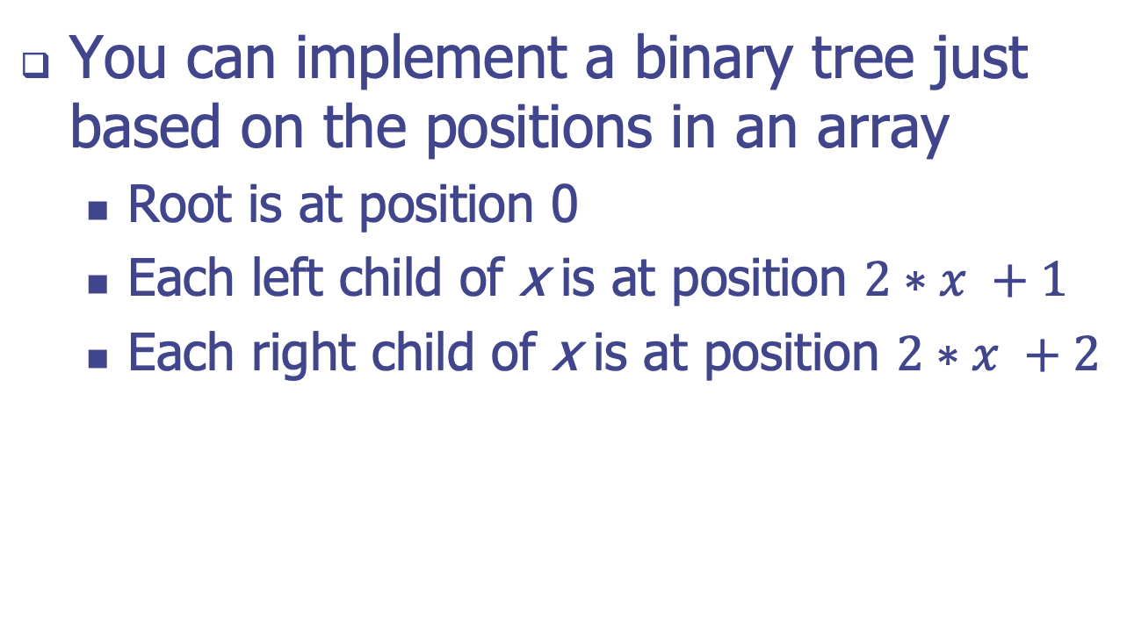
Array-Based Implementation of Binary Trees
You can implement a binary tree just based on the positions in an array
Root is at position 0
Each left child of x is at position $2∗x +1$
Each right child of x is at position $2∗x +2$
A
B
D
…
G
H
…
0
1
2
9
10

Slide 12
Array-Based Representation of Binary Trees
Nodes are stored in an array A
0
A
A
B
D
…
G
H
…
1
2
0
1
2
9
10
B
D
Node v is stored at A[rank(v)]
rank(root) = 0
if node is the left child of parent(node), rank(node) = 2 ⋅ rank(parent(node)) + 1
if node is the right child of parent(node), rank(node) = 2 ⋅ rank(parent(node)) + 2
3
4
5
6
E
F
C
J
9
10
G
H

Slide 13
Array-Based Implementation of Binary Trees
(a) A full binary tree with level numbering
(b) This binary tree has no nodes at 13 or 14

